Slide 1

CHM 101: Kinetic theory of matter (module B)
Dr T.A. Afolabi

Slide 2
The Density of a Gas
One mole of any gas occupies nearly the same volume at a given temperature and pressure, so difference in gas density (d = m/V) depend on differences in molar mass.
E.g. 1 mol of O₂ occupies the same volume as 1 mol of N₂, but since each O₂ molecule has a greater mass than each N₂ molecule, O₂ is denser.
All gasses are miscible when thoroughly mixed, but in the absence of mixing, a less dense gas will lie above a more dense one.

Slide 3
The ideal gas law can be used to calculate the density of a gas from its molar mass.
n = m/M
(n = No. of moles; m = mass; M = molar mass).
Recall PV = nRT
Therefore,
PV = mRT
M
Rearrange MP = m = density
RT V

Slide 4
This shows that:
The density of a gas is directly proportional to its molar mass because a given amount of a heavier gas occupies the same volume as that amount of a lighter gas (Avogadro’s law)
The density of a gas is inversely proportional to the temperature. As the volume of a gas increases with temperature (Charles’s law), the same mass occupies more space; thus, the density is lower.

Slide 5
Molar mass
To determine the molar mass of an unknown gas:
n = m = PV
M RT
M = mRT
PV
or
M = dRT
P

Slide 6
The partial Pressure of a gas
The ideal gas law holds for virtually any gas, whether pure or a mixture, at ordinary conditions for two reasons:
Gases mix homogenously (form a solution) in any proportions.
Each gas in a mixture behaves as if it were the only gas present (assuming no chemical interactions).

Slide 7
Dalton’s law of Partial Pressures: states that “in a mixture of unreacting gases, the total pressure is the sum of the partial pressures of the individual gases”.
P _{total} = P₁ + P₂ + P₃ + …
E.g. suppose a tank of fixed volume contains gas a and b. Each gas behaves independently,
P_{a} = n_{a}RT and P_{b} = n_{b}RT
V V
Each gas occupies the same total volume and is at the same temperature, the pressure of a gas depends on its amount, n.

Slide 8
Thus, the total pressure is:
P_{total} = P_{a} + P_{b} = n_{a}RT + n_{b}RT
V V
= (n_{a} + n_{b}) RT
V
= n_{total} RT
V
n_{total} = n_{a} + n_{b}
Each component in a mixture contributes a fraction of the total number of moles in the mixture, which is the mole fraction (X) of that component.

Slide 9
For n_{a}, the mole fraction is
X_{a} = n_{a} = n_{a}
n_{total} n_{a} + n_{b}
Since the total pressure is due to the total number of moles, the partial pressure of gas a is the total pressure multiplied by the mole fraction of a,
P_{a} = X_{a} . P_{total}

Slide 10
Exercise 8
If 4.58 g of a gas occupies 3.33 L at 27ºC and 808 torr, what is the molar mass of the gas?

Slide 11
Exercise 9
Calculate the amount of oxygen gas (O₂) in a cylinder of 30 L, if the pressure is 20 atm at 30°C.

Slide 12
Exercise 10
Calculate the absolute temperature of 0.118 mol of a gas that occupies 10.0 L at 0.933 atm.

Slide 13
Exercise 11
What is the pressure of H₂ if 0.250 mol of H₂
and 0.120 mol of He are placed in a 10.0-L vessel at 27ºC.

Slide 14
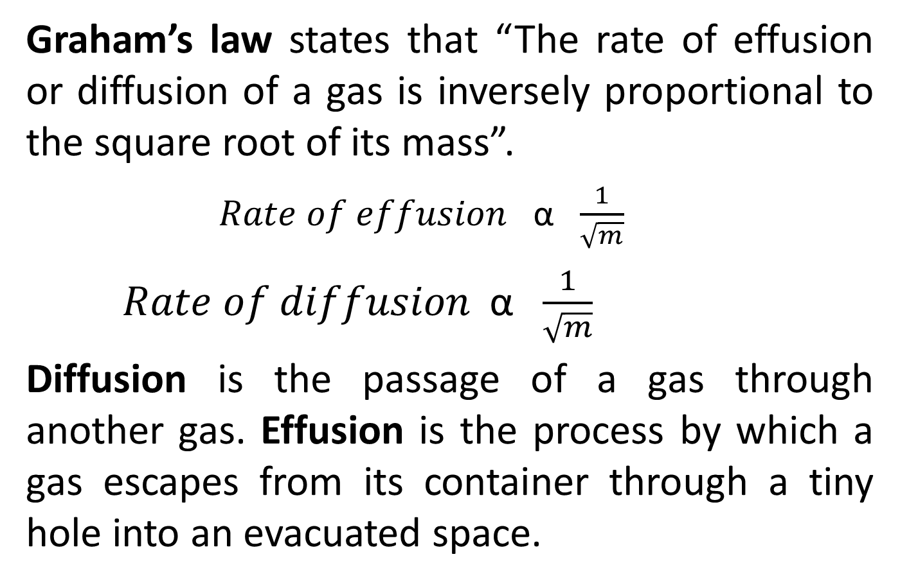
Graham’s Law
Graham’s law states that “The rate of effusion or diffusion of a gas is inversely proportional to the square root of its mass”.
$Rate of effusion$α $\frac{1}{\sqrt{m}}$
$Rate of diffusion$α $\frac{1}{\sqrt{m}}$
Diffusion is the passage of a gas through another gas. Effusion is the process by which a gas escapes from its container through a tiny hole into an evacuated space.

Slide 15
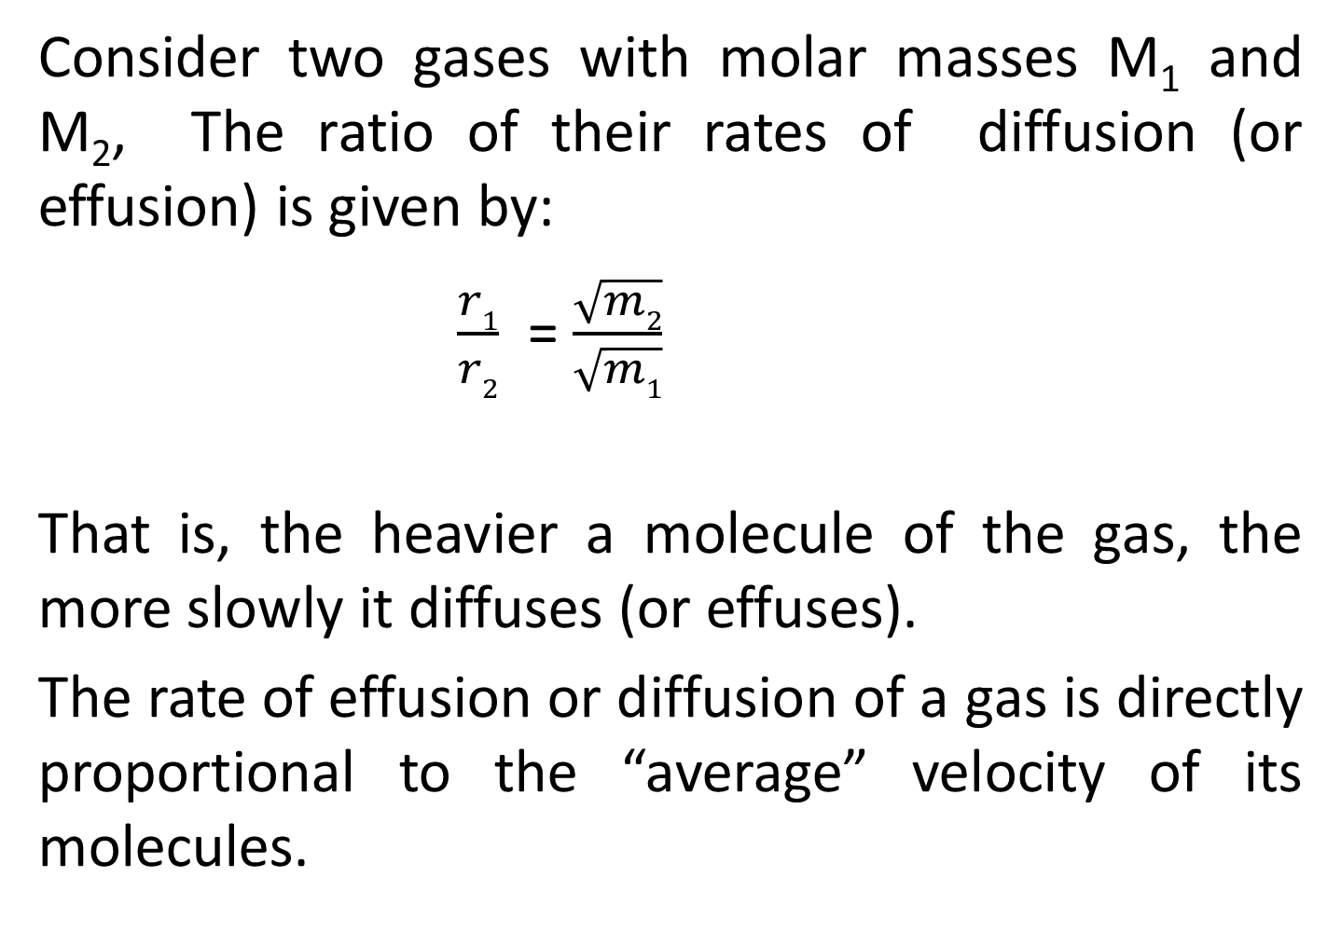
Consider two gases with molar masses M₁ and M₂, The ratio of their rates of diffusion (or effusion) is given by:
$\frac{r1}{r2}$ = $\frac{\sqrt{m2}}{\sqrt{m1}}$
That is, the heavier a molecule of the gas, the more slowly it diffuses (or effuses).
The rate of effusion or diffusion of a gas is directly proportional to the “average” velocity of its molecules.

Slide 16
Kinetic Molecular Theory
The theory is based on 3 postulates (assumptions):
1. Particle volume: A gas consists of a large collection of individual particles. The volume of an individual particle is extremely small compared with volume of the container. In essence the model pictures gas particles having mass but no volume.

Slide 17
2. Particle motion: Gas particles are in constant, random, straight-line motion except when they collide with the container walls or with each other.

Slide 18
3. Particle collisions: Collisions are elastic, hence their total kinetic energy is constant. Between collisions, the molecules do not influence each other at all.

Slide 19
KINETIC MOLECULAR THEORY ( the model)
Gases are composed of small particles (atoms or molecules).
These particles move rapidly in a random, straight line motion. Particles will collide with each other and with the walls of the container.

Slide 20
The bonding forces between particles are extremely weak. It is assumed that particles move around independently.
Collisions between particles are elastic, i.e. energy is conserved.

Slide 21
Kinetic energy (energy of movement) can be transferred from one particle to another, but the total kinetic energy will remain constant.
The average kinetic energy of the particles increases as the temperature of the gas is increased.

Slide 22
Exercise 12
A sample of calcium carbonate, mass 1.0 g, is heated until it has decomposed completely. Calculate:
a) the mass of carbon dioxide produced
b) the volume of carbon dioxide, measured at STP
SOLN:
Molar mass of CaCO₃, M = 100g/mol

Slide 23
n _{CaCO3} = m
M
= 1g/100gmol⁻¹
= 0.01mol CaCO₃
Using the mole ratio from the equation above;
n (CO₂) = 1/1 x n (CaCO₃)
= 0.01mol CO₂
Mass of CO₂ required = n _{(CO2)} x M _{(CO2)}
= 0.01 mol x 44g/mol
= 0.44 g
1 mol of any gas at STP = 22.4L
0.01 mol of CO₂ = 22.4 L x 0.01mol
1mol
= 0.224 L

Slide 24
Exercise 13
Copper dispersed in absorbent beds is used to react with oxygen impurities in the ethylene used for producing polyethylene. The beds are regenerated when hot H₂ reduces the metal oxide, forming the pure metal and H₂O. On a laboratory scale, what volume of H₂ at 765 torr and 225ºC is needed to reduce 35.5g of copper (ii) oxide?
SOLN:
To find V_{H2}, n_{H2} must first be determined
Write the equation for d reaction
Solve for n (stoichiometry), then solve for V (gas law)

Slide 25
Equation for the reaction:
Molar mass of CuO = 79.5 g/mol
79.5 g/mol of CuO >>>> 1 mol of H₂
35.5 g of CuO >>>>> 1 mol x 35.5 g/mol 79.5 g/mol
= 0.446 mol of H₂
(Note stoichiometry of reaction 1:1)
Given: P = 765 torr = 1.01 atm
T = (225 +273) = 498K

Slide 26
Exercise 14: What is the density of methane, CH₄, at 20°C and 2.00 atm.
Exercise 15: What is the molar mass of a gas whose density at 40°C and 785 torr is 1.286 kg/m³
Exercise 16: A collapsed balloon and its load weighs 216 kg. To what volume should it be inflated with H gas in order to launch it from a mountain top at -12°C and 628 torr? The density of air under these conditions is 1.11 g/L.

Slide 27
Exercise 17: An organic compound containing 55.8% C, 7.03% H, and 37.2% O; was found to have a gas density of 2.83 g/L at 100°C and 740 torr. What is the molecular formula of the compound?
[[Ans: Empirical formula is C₂H₃O; molar mass = 89g/mol. Divide 89g/mol by 43g/mol (C₂H₃O molar mass) = 2. Therefore molecular formula is C₄H₆O₂ ]]

Slide 28
Exercise 18: Chlorine gas is evolved at the anode of a commercial electrolysis cell at the rate of 3.65 L/min, at a temperature of 647°C. On its way to the intake pump it is cooled to 63°C. Calculate the rate of intake to the pump assuming the pressure has remained constant.

Slide 29
Exercise 19: A spark was passed through a 50cm³ sample of a H₂/O₂ mixture in a gas burette at 18°C and 1.00 atm; the formation of water went to completion. The resulting dry gas had a volume of 10 cm³ at 18°C, 1.00 atm. What was the initial mole fraction of H in the mixture if:
(a) the residual gas after sparking was H₂
(b) the residual gas was O₂ ?

Slide 30
Exercise 20: A rigid plastic container holds 35.0g of ethylene gas (C₂H₄) at a pressure of 793 torr. What is the pressure if 5.0g of ethylene is removed at constant temperature?
Exercise 21: A scale model of a blimp rises when it is filled with helium to a volume of 55.0dm³. When 1.10mol of He is added to the blimp, the volume is 26.2 dm³. How many more grams of He must be added to make it rise? Assume constant T and P.

Slide 31
ANY QUESTIONS?!

Slide 32

HAPPY NEW YEAR
Notes:
(solvent + lysis = solvolysis).
When solvent is water = Hydrolysis.
When it is methanol = methanolysis.

